Slide 1
Programming Structures & Algorithms Final Project Weighted Graphs
Angel N. Fernandes

Slide 2
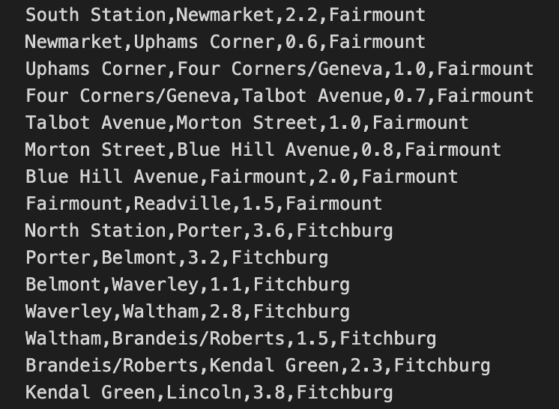
Data Description
A compilation of 99 entires.
Each entry in the dataset represents a segment of the commuter rail network, including the starting station, ending station, distance in miles, and the associated rail line.

Slide 3
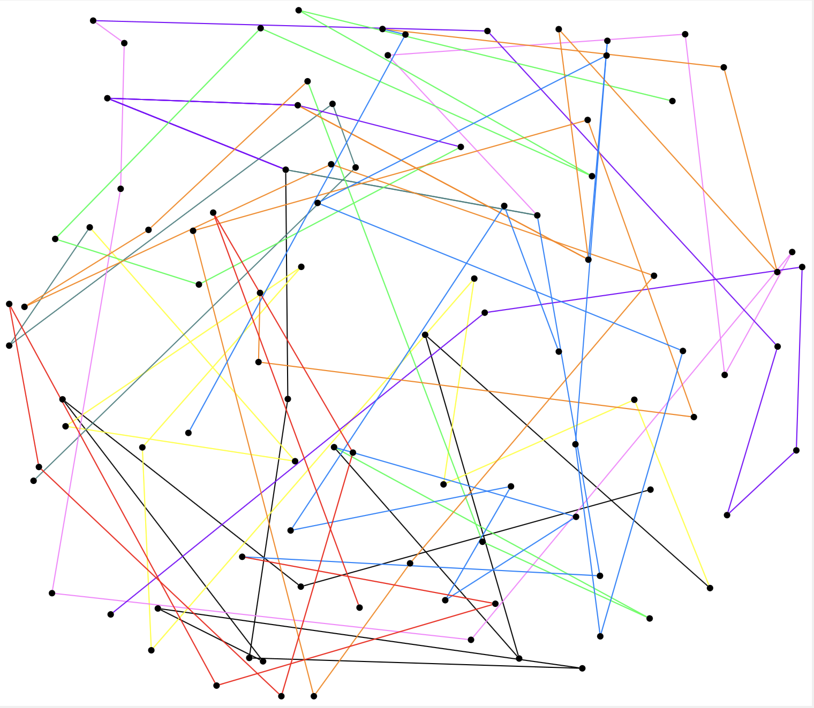
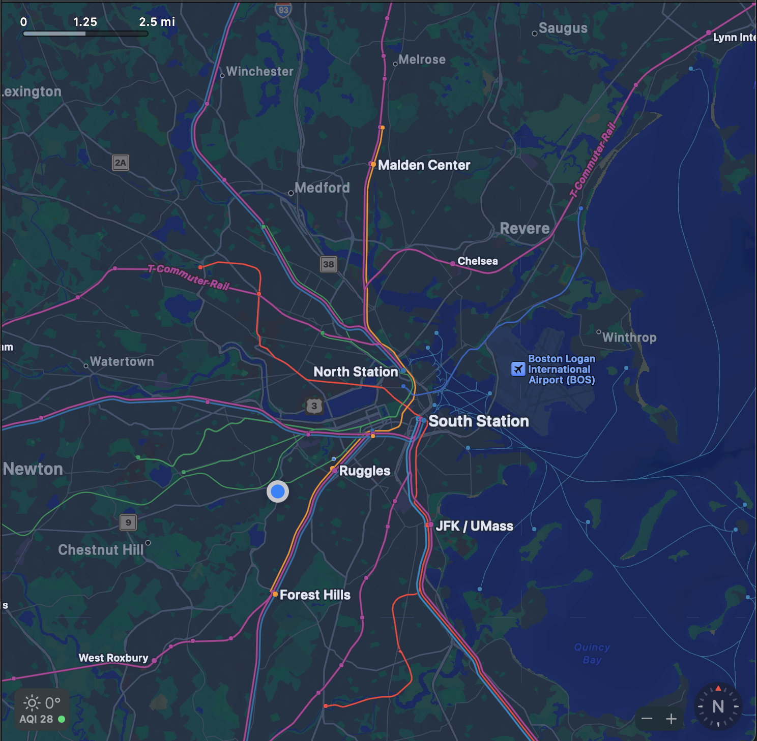

Slide 4
Algorithms Used
Dijkstra’s Algorithm (SSSP)
Floyd Warshall Algorithm (MSSP)
Bellman-Ford Algorithm
Kruskal’s Algorithm (MST)
Prim’s Algorithm (MST)

Slide 5
Dijkstra’s Algorithm
Used to find the shortest path from a single source vertex to all other vertices in a weighted graph with non-negative edge weights.
Application:
Find the shortest path between any two commuter rail stations.
Helps commuters plan their journeys efficiently by identifying the fastest route between their origin and destination stations
Time Complexity: O(V²)
Space Complexity: O(V)
Notes:
The outer loop runs V - 1 times, where V is the number of vertices.
Within each iteration of the outer loop, the inner loop runs E times, where E is the number of edges.
Hence, the total number of iterations of the inner loop is at most (V - 1) * E.

Slide 6
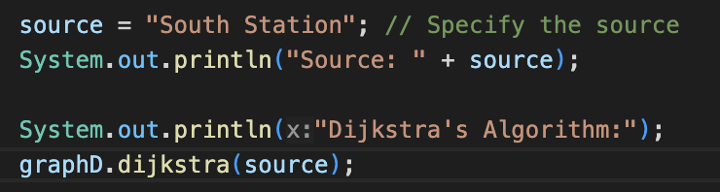
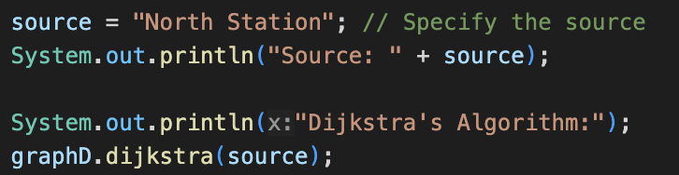
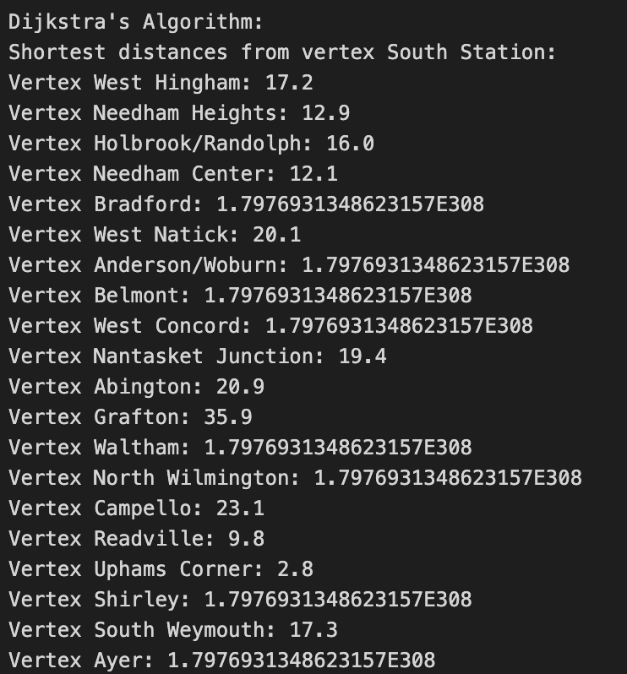
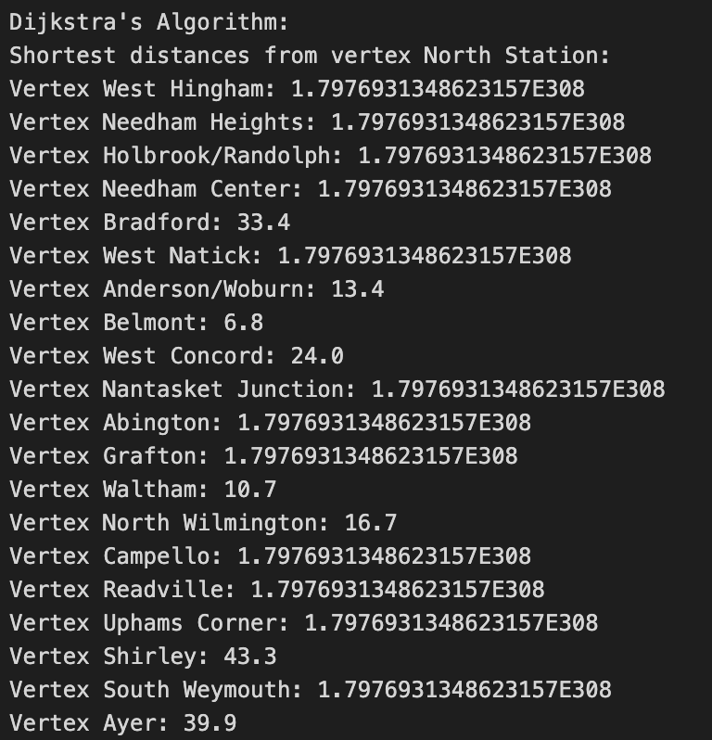
Notes:
It initializes a graph with a specified number of vertices.
It allows adding edges between vertices with specified weights.
It implements Dijkstra's algorithm to find the shortest distances from a given source vertex to all other vertices in the graph.
It prints the shortest distances from the source vertex to all other vertices.
It provides a method to print the graph in a readable format.

Slide 7
Bellman-Ford’s Algorithm
Used to find the shortest paths from a single source vertex to all other vertices, even in graphs with negative edge weights.
Application:
Can provide flexibility in case the commuter rail network undergoes changes or extensions, ensuring reliable pathfinding even in dynamic environments
Time Complexity: O(V*E)
Space Complexity: O(V)
Notes:
There are three nested loops iterating over all vertices (V) for each iteration. This results in a cubic time complexity.
The outermost loop runs V times.
The middle loop runs V times, nested within the outer loop.
The innermost loop also runs V times, nested within the middle loop.
Therefore, the total number of iterations is V * V * V, which simplifies to O(V^3).

Slide 8
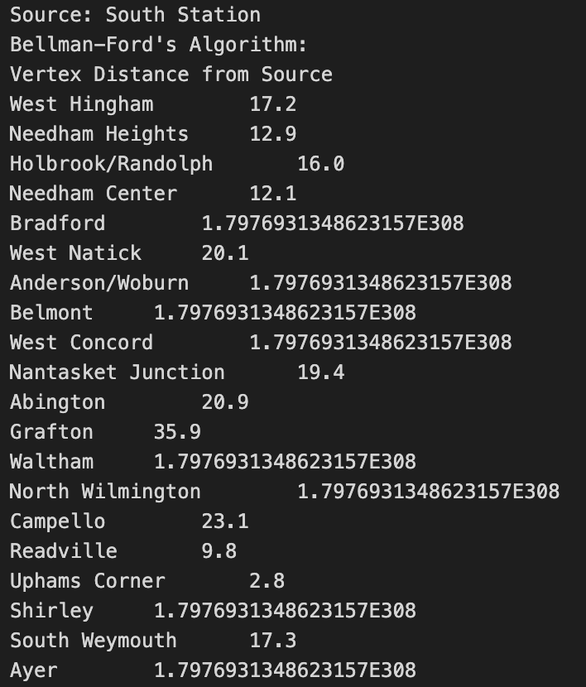
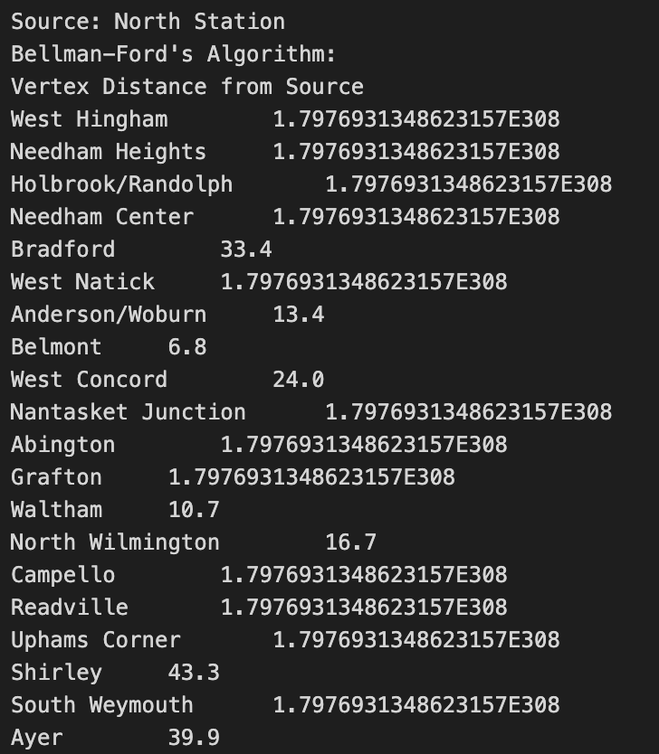

Slide 9
Floyd Warshall’s Algorithm
Used to find the shortest paths between all pairs of vertices in a weighted graph, including negative edge weights.
Application:
can provide comprehensive information about the shortest paths between all pairs of commuter rail stations.
Useful for network analysis, identifying bottleneck stations, or understanding the overall connectivity of the commuter rail system.
Time Complexity: O(V³)
Space Complexity: O(V²)
Notes:
There are three nested loops iterating over all vertices (V) for each iteration. This results in a cubic time complexity.
The outermost loop runs V times.
The middle loop runs V times, nested within the outer loop.
The innermost loop also runs V times, nested within the middle loop.
Therefore, the total number of iterations is V * V * V, which simplifies to O(V^3).

Slide 10
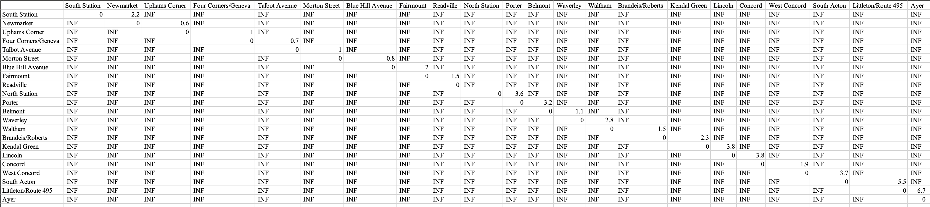
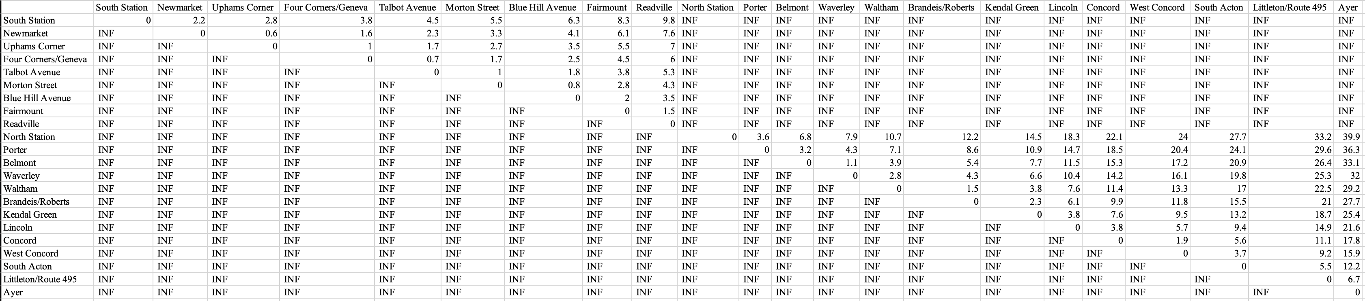
Original Matrix
After Algorithm
Notes:
The floydWarshall method computes the shortest distances between all pairs of vertices using the Floyd-Warshall algorithm.
It iterates through all vertices and computes the shortest distance between each pair of vertices via intermediate vertices.
It rounds the distances to one decimal place.
The printMatrix method prints the resulting adjacency matrix, representing the shortest distances between all pairs of vertices.
It also prints the labels of vertices for better readability.

Slide 11
Kruskal’s Algorithm
Used to find the minimum spanning tree (MST) of a connected, undirected graph with weighted edges.
Application:
Identify the most efficient way to connect all the commuter rail stations while minimizing the total distance traveled.
Help in optimizing the overall layout of the commuter rail network.
Time Complexity: O(E log V)
Space Complexity: O(V+E)
Notes:
Sorting edges: Sorting the edges based on their weights takes O(E log E) time, where E is the number of edges in the graph. In your implementation, you sort the edges using Collections.sort(edges), which has a time complexity of O(E log E) since edges contains all the edges in the graph.
Union-find operations: In Kruskal's algorithm, the findParent operation and the union operations take nearly constant time, specifically O(log V) on average, where V is the number of vertices. However, because the union operation might be called up to E times, its total complexity becomes O(E log V). This is because each edge's endpoints are represented as disjoint sets, and the algorithm iterates over all the edges, potentially performing union operations.
Overall complexity: Since sorting dominates the time complexity, the overall time complexity of Kruskal's algorithm is O(E log E). In the worst-case scenario, this can be simplified to O(E log V), as E is always less than or equal to V^2, and log(V^2) = 2 * log V, which is equivalent to O(log V).

Slide 12
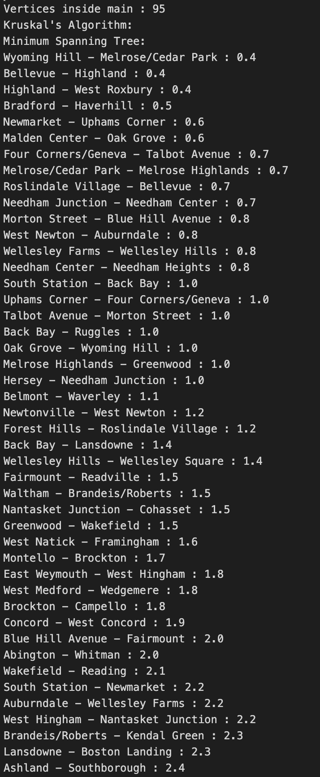
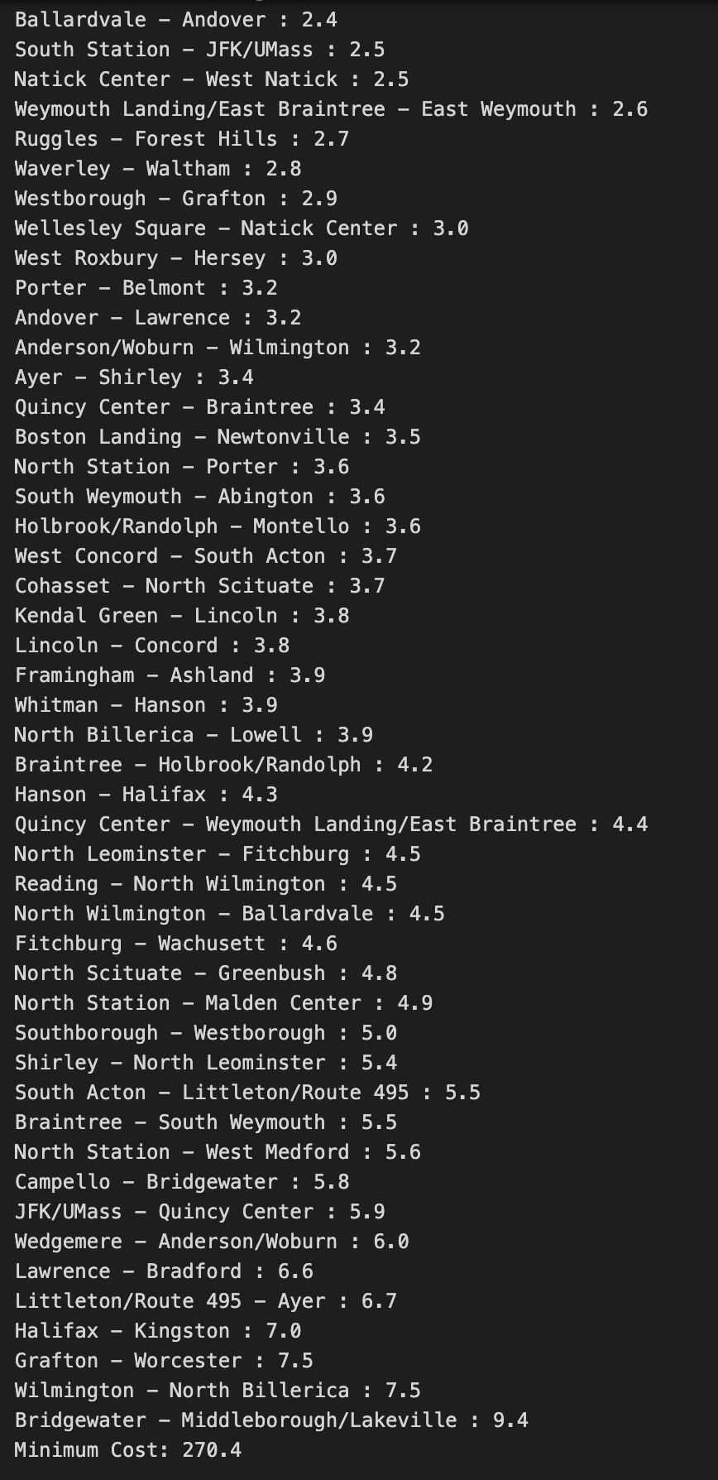
Notes:
Reading Input from File:
It reads data from a file named "RailData.txt", which contains information about edges (source, destination, weight) in comma-separated format.
Initialization:
It initializes data structures to store mappings between vertex labels and indices (labelToIndex), an ordered list of vertex labels (labelsInOrder), and a map to store edge weights (edgeWeights).
Constructing the Adjacency Matrix:
It constructs an adjacency matrix based on the read data, where each cell represents the weight of an edge between two vertices.
Kruskal's Algorithm:
It applies Kruskal's algorithm to find the Minimum Spanning Tree (MST) of the graph.
It initializes a list of edges (edges) and sorts them based on their weights.
It initializes a parent array for union-find operations.
It iterates through sorted edges, adding them to the MST if they don't create a cycle.
It calculates the total weight of the MST and prints the edges along with their weights.
Union-Find Operations:
It defines a helper method findParent to find the parent of a vertex in the union-find data structure.

Slide 13
Prim’s Algorithm
Used to find the minimum spanning tree (MST) of a connected, undirected graph with weighted edges.
Application:
identify an efficient layout of the commuter rail network by finding the minimum spanning tree.
Helps in determining which connections between stations are essential to maintain an efficient and well-connected network.
Time Complexity: O(V²)
Space Complexity: O(V)
Notes:
The function minKey iterates over all vertices (V) to find the vertex with the minimum key. This operation takes O(V) time.
The main loop in the primMST function runs V - 1 times, and within each iteration, it potentially examines all edges connected to the current vertex. If a priority queue or a binary heap were used, the operation of extracting the minimum key vertex and updating adjacent vertices would take O((V + E) log V) time overall. However, since your implementation uses a linear search to find the minimum key vertex, the time complexity becomes O(V^2).

Slide 14
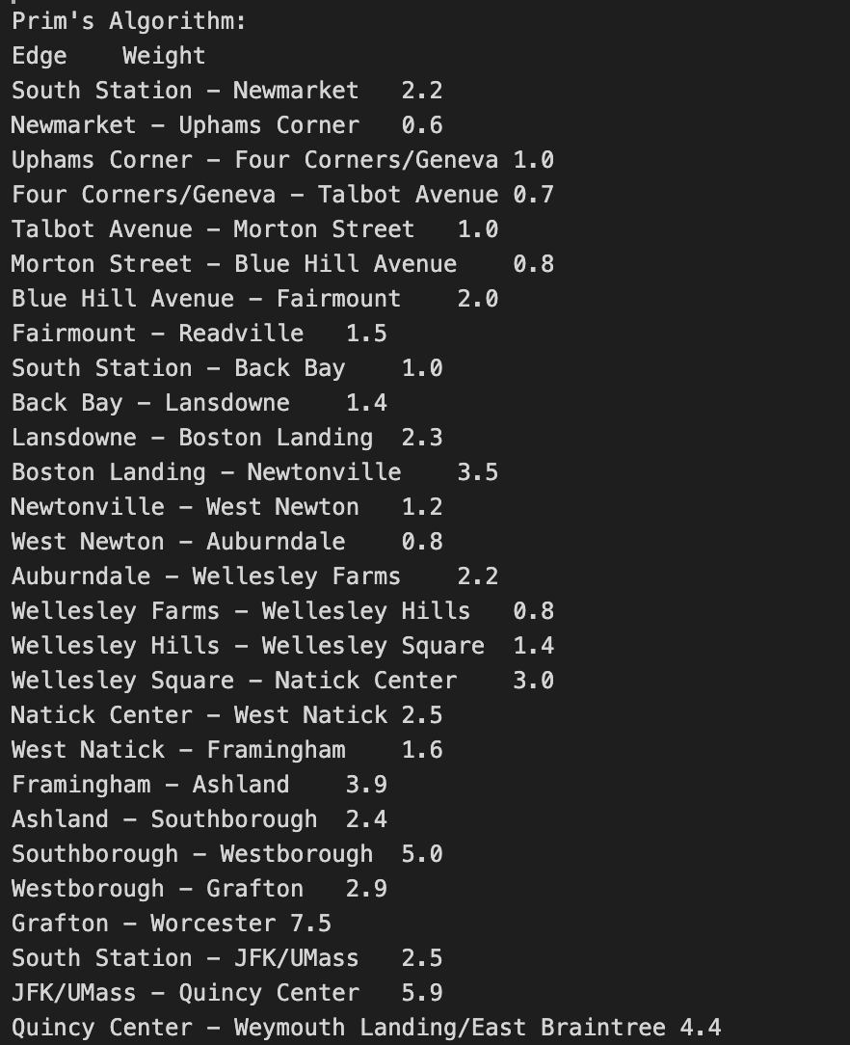
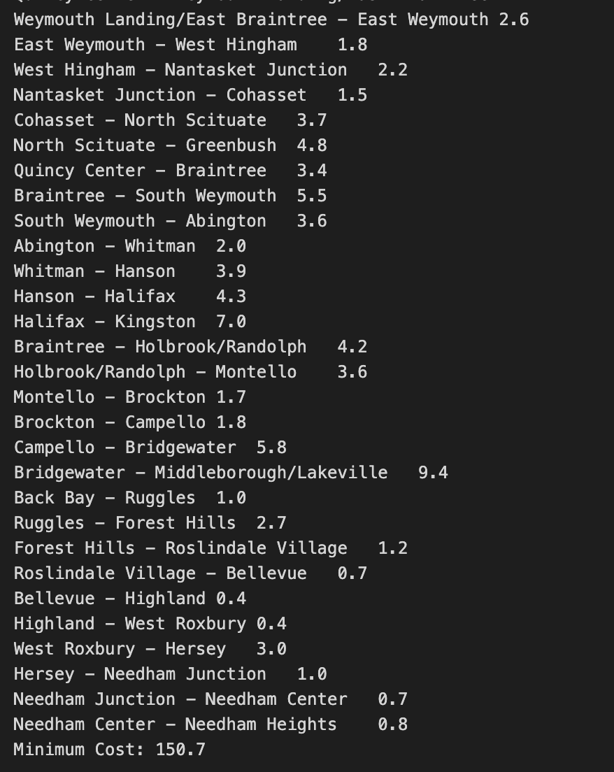
Notes:
minKey Method:
It finds the vertex with the minimum key value from the set of vertices not yet included in the MST.
It returns the index of the vertex with the minimum key value.
primMST Method:
It initializes arrays to store the parent vertices, key values, and the set of vertices included in the MST.
It initializes the key value of the first vertex as 0 and sets its parent as -1.
It iterates through all vertices to find the minimum key vertex, adds it to the MST set, and updates the key values and parent pointers of adjacent vertices if necessary.
It prints the MST as a set of edges along with their weights.
Overloaded primMST Method:
This version of the method also takes an additional parameter labelsInOrder, which represents the ordered list of vertex labels.
It prints the MST with vertex labels instead of indices.
It calculates and prints the total weight of the MST.
printMatrix Methods:
These methods print the MST edges along with their weights.
The first method prints the MST using vertex indices.
The second method prints the MST using vertex labels from labelsInOrder.

Slide 15
Thank you!

